Slide 1
Java Production Debugging 101
A Reversim Summit Lab
February, 2013

Slide 2
Production Debugging = Forensics
CSI clipart
Stupendous statement!

Slide 3
Business Requirements
Requirements | Prod. Debugging | Forensics
Timeframe | Severely limited | Hours, days, weeks…
Chain of Custody | Meaningless | Sacred
Documentation | Useful | Sacred

Slide 4
Endgame
Production Debugging | Forensics
1. Gather evidence | 1. Identify crime in progress
2. Restore functionality | 2. Gather evidence
3. Figure out what happened

Slide 5
Our Forensic Process
Gather Evidence
Restore Production
Analyze Findings
Implement Solution
Post-Mortem

Slide 6
Evidence Toolchain
CSI clipart #2
Ye olde

Slide 7
What shall we collect?
“Evidence” logo + suitable clipart
Notes:
Invite discussion. Ask audience to point out different data that is (a) useful and (b) readily accessible. Limit to 3 minutes.

Slide 8
Our focus points for today
Thread dump
Heap dump
VM (especially GC) metrics
System metrics
Logs
Notes:
Expound a bit on anything that hasn’t been raised in the earlier discussion. Limit to 2 minutes, less if possible.

Slide 9
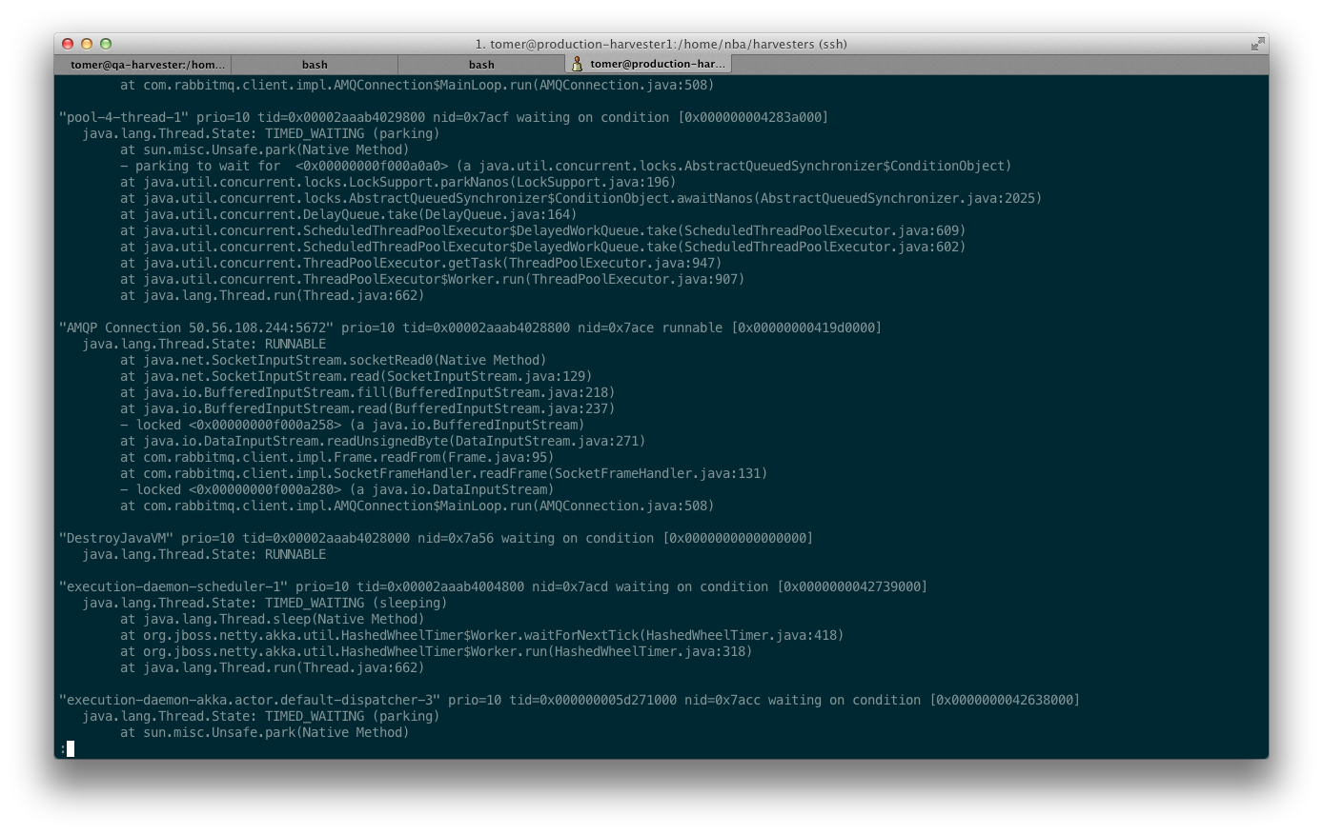
jstack
Minimalistic tool
Against a running process: jstack <pid>
Outputs to stdout
Identifies deadlocks

Slide 10
jmap
Heap-dump from a running process
Lengthy process
Freezes VM
Some extras
Command: jmap –dump:format=b,file=<output> <pid>

Slide 11
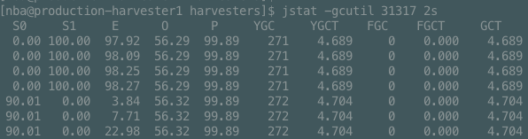
jstat
JVM metrics: classloader, JIT, GC
Tracking over time
Console-based
jstat –gcutil <pid> 5s

Slide 12
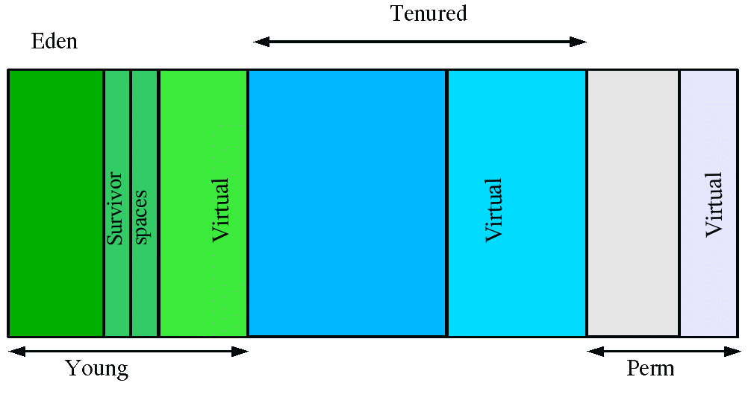
(optional) The JVM GC

Slide 13
jvisualvm
Screenshot comes here
Combines most of the above, with GUI
Remote via X11 forwarding (dreadful!)
Quick overview/demo (2 minutes)
Notes:
“All this and more” sales pitch. Mention the profiler.

Slide 14
Shall we dance?
Appropriate clipart (lounge party) comes here

Slide 15
Scenario 1
(violent alarm clock clipart)
Phone call in the middle of the night
“the application is stuck!”
What do you do?
(Kiano Reeves shot)
Notes:
Actual scenario details: pathological regular expression in a service (http://swtch.com/~rsc/regexp/regexp1.html).
Exhibited behavior: very high single-core CPU utilization. Little or no GC activity. Possible StackOverflow if left long enough
Analysis: stack trace will exhibit very deep, repetitive call stack to java.util.* classes. Package and class names will indicate a regex issue.
Bonus points to whomever recognizes the pathological regex scenario without looking at the code, beyond the “problematic Regex” axiom.
Workaround: depends on the details, in some cases the offensive input can be deleted or routed to a dead letter queue. In this case, none – this has to be resolved at the algorithmic level.

Slide 16
Scenario 2
Looks familiar?
“The application is crawling to a halt!”
“So restart it.”
“OK, it’s good now.”
This is a lie.
You will get another call.
“you can’t handle the truth” shot
Notes:
Actual scenario details: GC storm as a result of exponentially-growing HashMap. Adding small elements to a java.collection.HashMap rapidly without specifying an appropriate capacity is a recipe for disaster.
Exhibited behavior: ~100% single-core CPU utilization. Very high GC activity – eden generation fills up rapidly, overflowing to old gen with FGCs in increasing frequency. Eventual OutOfMemoryException.
Analysis: jstat –gcutil or tracking the graphs in VisualVM clearly exhibit high GC pressure and inability to clear up enough RAM on each GC cycle. Stack trace will exhibit a thread very clearly working on HashMap.resize. Heap dump will also exhibit a HashMap with very high load factor and an appropriately high count of items in the map.
Bonus points to whomever recognizes the exponential expansion scenario without looking at the code.
Workaround: restart the service, and possibly set up a cron task to restart periodically. VM flags that watchdog OOM situations are useless because OOME fires way too late, if at all.

Slide 17
Scenario 3
1st tier support engineer (maybe you?) calls:
“I get OutOfMemoryExceptions on this service.”
“Restart it.”
“Already have. Happened again.”
“Well, shit.”
Appropriate clipart for “wake up and smell the coffee.”
Notes:
Actual scenario details: Memory leak as a result of saving substrings from web calls. Substring actually references the original string, or in practical terms the resulting HTML from each website is kept in active memory until a large-enough allocation fires OOME.
GC isn’t overwhelmed because it mostly has large, long-lived objects, so once memory is defragment (a single FGC cycle) it just doesn’t have much it can do about the memory pressure.
Exhibited behavior: Service process dead. OOME clearly marked in the logs.
Analysis: Save logs aside; restart application to collect more information. jstat –gcutil output and a pre-failure thread dump should be saved aside as a matter of good course, but are not useful in the analysis of this scenario. Either saving pre-failure heap dumps or turning on the -XX:+HeapDumpOnOutOfMemoryError JVM option is necessary to resolve this problem.
Bonus points for legitimate scenario suggestions at this point, but cut it off very quickly as a good lesson in “not jumping ahead of our data.”
Workaround: restart the service, and possibly set up a cron task to restart periodically. VM flags that watchdog OOM situations can help.

Slide 18
BREAK TIME!
“Enjoy jojo” clipart
Notes:
5-10 minutes

Slide 19
Forensic Toolchain
Appropriate clipart goes here
Without further ado…

Slide 20
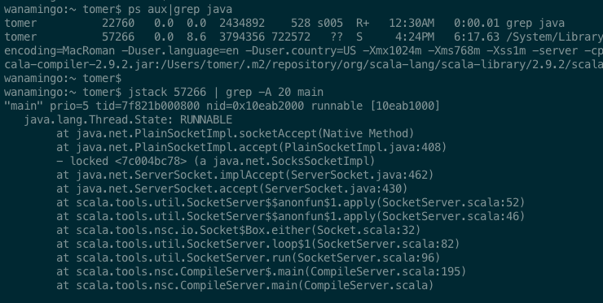

GNU toolchain is your friend
bash, ps, grep, less, awk
‘nuff said
… or:
http://gnuwin32.sourceforge.net/

Slide 21
MAT
… insert MAT screenshot
5-minute overview+demo of MAT
Leak detection report
Object traversal

Slide 22
Resolution Time!
A “rock’n’roll” shot comes here

Slide 23
Back to: Scenario 1
What did we gather?
CPU – 100% single-core utilization
GC metrics – no useful data
Heap dump – no useful data
Thread dump
java.util.Regex * gazillion
Where the problem is implies… → what the problem is
Notes:
TODO animate list. Follow through on evidence in the form of discussion (who used…? What did you find?) – don’t discount useful alternative theories!
Forensic analysis: read through stack trace. Identify likely culprit. Bonus points to whomever yells “pathological regex” first.

Slide 24
Back to: Scenario 2
What did we gather?
CPU – 100% single-core utilization
Heap dump – no useful data
GC metrics
Frequent, long GCs (GC, FGC, FGCT)
Thread dump
HashMap.resize
Rapid HashMap insertions
No capacity planning
Recipty for disaster
Notes:
Heap dump actually has useful data (hashmap capacity, size and load factor) but it’s not likely anyone will notice that.
Forensics: jstat –gcutil clearly shows GC storm. Stack trace to figure out the where, and common sense to figure out the why.

Slide 25
Back to: Scenario 3
What did we gather?
CPU – low utilization
Thread dump – no useful data
GC metrics – high heap utilization, low GC pressure
Heap dump
Predictably high number of strings
Strings are abnormally large
Strings contain entire HTML subset!
Substring/regex can be dangerous!
Notes:
Forensics: Analyzing the heap dump will clearly evidence an abundance of suspiciously-large strings; drilling into a couple of these will let us see that the strings kept in the heap are in fact full-blown HTML responses.
Bonus points to whomever recognizes the substring scenario without looking at the code (nBA employees don’t count ☺).

Slide 26

Afterword
Headache? Take two of these!

Slide 27
Adieu
Thank you for attending!
Presentation and demos: http://github.com/… http://slideshare.net/…
Tomer Gabel
tomer@tomergabel.com
http://www.tomergabel.com/
@tomerg

